Slide 1
Project Night terror
Evan Geissler
Notes:
**Randomly generate where texts are, items are, placements, etc. Core static, other stuff different.

Slide 2
Project advisor
Trevor Douglas

Slide 3
introduction
What is Project Night Terror?
An Intro to the Story
Game Play
Main Technologies Used:
Game Engine
Asset Creation
Character Creation
Animation
Other
Main Goals
Secondary Goals

Slide 4
What is Project Night Terror?
A first person horror game based around terrifying and unsettling themes including death, depression, and terror
3D realistic graphics and animations
Single player & offline
Inspired by real life locations
Fort San to Labret area, etc.
Inspired by Saskatchewan ghost stories
Fort San, Camp Gilwell, etc.

Slide 5
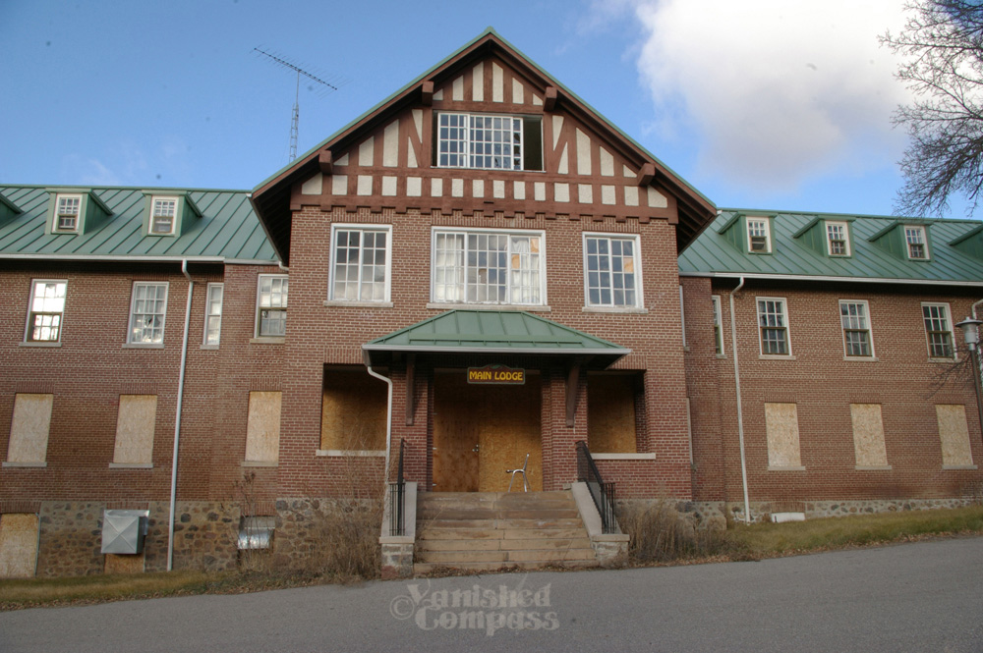
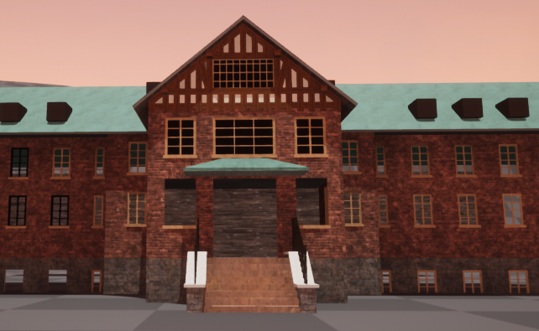
What is Project Night Terror?

Slide 6
An Intro to the Story
While outside your quiet cabin in the valley, a ghost emerges from the trees and calls for you to follow it. Unsure, but intrigued, you follow the ghost deep into the trees; opening your eyes to the horrors of the dead in the valley. You continue to follow the ghost, witnessing demons laying havoc to the areas and people around you. It is up to you to uncover the secrets of what happened and ensure that the demons are banished. Is the old research institute to blame or do the people of the valley hold the key to mysterious dark secrets?

Slide 7
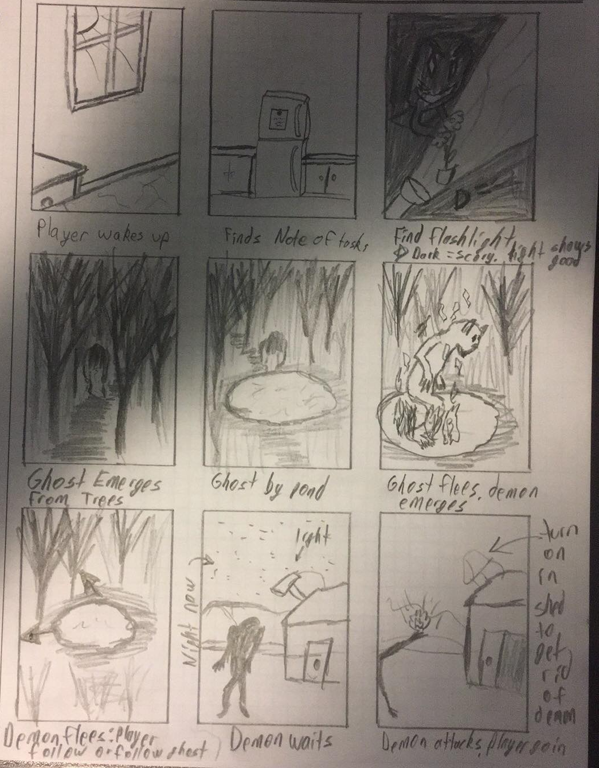
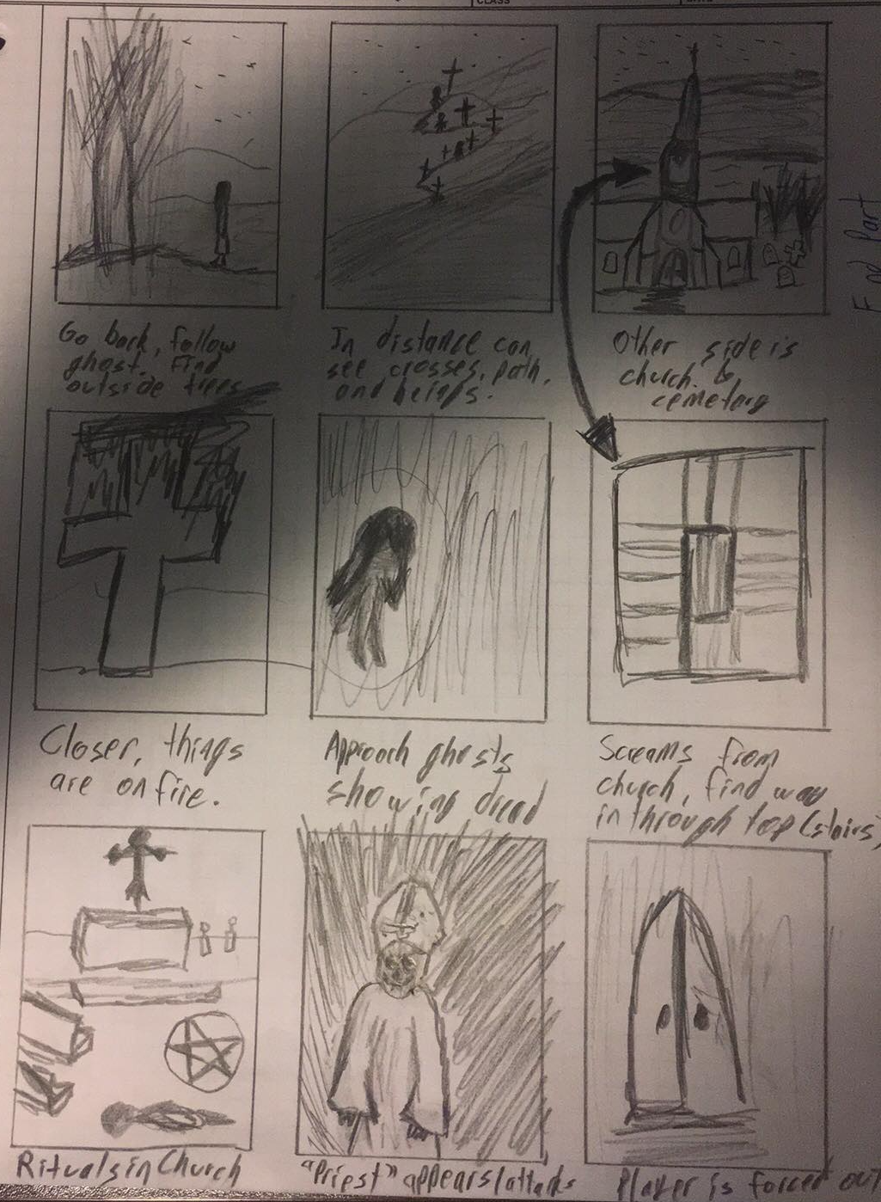
An Intro to the Story

Slide 8
Gameplay
One map split into areas
Ex. First area starts at the Cabin, Second at a church.
Story mostly told by
Finding letters, messages, etc. across each area
In game scenes (NPCs interacting with player, environment, or other NPCs)
Interaction with NPCs
Attacking (Flashlight, environmental, etc.)
Passive (ex. NPC sees you & attacks)
Dialogue choices (ex. Do you like SSE? Yes or No?)

Slide 9
Gameplay
To progress in the game, player completes objectives given by
1) Main NPC you follow
2) Other NPCs
3) Letters found in an area
Side objectives are available in each area, but not required
Finding more letters, messages, etc. and completing side objectives gives player more story and background.

Slide 10
Tech Used: Game Engine
Unreal Engine 4
Unity
Borderlands, BioShock, Fortnite
Better for Console gaming & 3D
Lots of training documentation
C++, blueprints
Free to use (5% royalty after first $3000 per quarter from commercial product)
Large community
Deus Ex, Hearthstone, Kerbal Space program
Better for Mobile gaming
Quick to learn
JavaScript, C#
Free if commercial product makes <100 000$
Huge marketplace

Slide 11
Tech Used: Game Engine
Chrome, CryEngine, Frost Bite Engine
Some reasons not used:
Could not find a lot of information
Did not fit project
Could not access
Decided on Unreal Engine 4 (UE4, Unreal)

Slide 12
Tech used: Asset creation
Unreal Engine
Blender
Static meshes, materials, Binary Space Partitioning (BSP), etc.
Large amount of starter content
Standard is 20% BSP and 80% static mesh
Free
Static meshes
Can create animations
Easy to learn and use

Slide 13
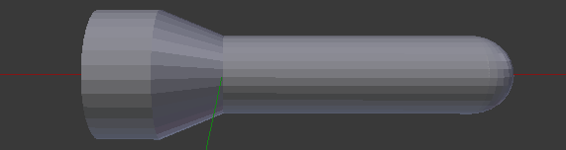
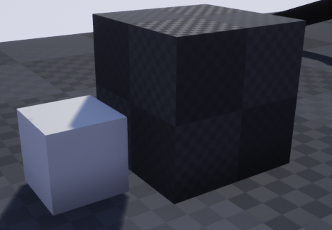
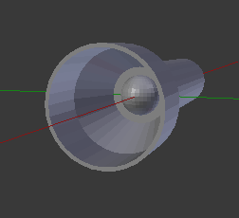
Tech used: Asset creation
Unreal Engine
Static Mesh (Left) BSP (Right)
Blender Static Mesh Flashlight

Slide 14
Tech Used: Character creation
Unreal Engine
Adobe Fuse
Can add more components to characters
Ex. Point light
Ex. Items
Custom AI per character
Free to use
Works hand-in-hand with Mixamo & Unreal
Multiple pre-made characters
Completely adjustable
Ex. Length of body parts
Ex. Dirt level on clothes

Slide 15
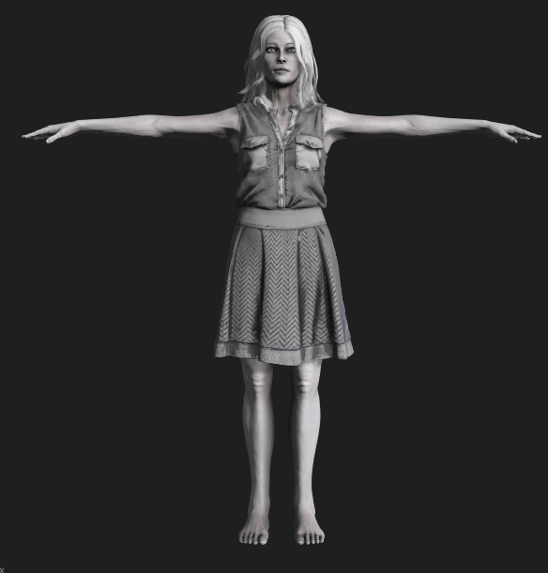
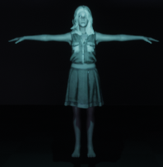
Tech Used: Character creation
Ghost in Adobe Fuse
Ghost in Unreal with Point Light

Slide 16
Tech Used: Animation
Unreal Engine
Mixamo
Cut scenes
Matinee scenes
Ex. Door opening
Character animation
Combining multiple animations from Mixamo
Code on when or where to use specific one
Free to use
Works hand-in-hand with Unreal & Adobe Fuse
Character Animation
Individual animation
Thousands of animations available

Slide 17
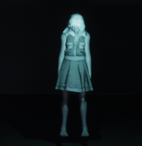
Tech Used: Animation
Standard T Pose
Idle Animation (Still frame)

Slide 18
Tech Used: Other
Terrain.party – Landcaping
Garage Band – Music/SFX
Audacity – Music/SFX/Voice Audio
Github – Source Control
Epic Games Marketplace – Free assets

Slide 19
Main goals
Realistic Landscape & Environmental Creation
Key buildings with interiors and/or exteriors
Qu’Appelle Valley area
Two main Non-Playable Characters (NPCs)
Passive ghost (guides player)
Mostly passive demon (main antagonist)
Multiple NPC with Varying AI
Passive NPC mostly minimum AI (walking around, etc.)
Various Enemy AI levels (Attacks, abilities, etc.)
Dynamic Menus
Changes as player progresses
Ex. Main Menu environment changes from sunny to stormy

Slide 20
Main Goals
Multiple Items
Flashlight
Notebook
Etc.
Upgradable Items
Optional (Can complete game without them)
Usually obtained in side objectives
0 to 3 upgrades per item
Save Game
Ability to save progress and return to that point without penalty

Slide 21
Main Goals
Start to Finish Aspects
Main menu
Opening
Main Game
Credits
At Least Some Music & Sound Effects
Collectables
Letters, texts, messages, etc.
Objects that relate to area
Set of side objective

Slide 22
Secondary goals
Easter eggs & references
Trophies, achievements, etc.
Multiplatform
Currently only for CPU, hoping to expand to PS4, Xbox1
New game+ (second play through)
Harder and different NPC AI
Level changes

Slide 23
Secondary Goals
Complete Set of Music & Sounds
Voice Acting
More Items
More Details
Environment (Nicer grass, water, etc.)
Items (Intricate design)

